Slide 1

Anomaly Detection in vessel traffic
A SAAB production

Slide 2
Last week
Literature study
Informational poster -> Saab office
Wednesday:
Sprint Review
Sprint Retrospective
Sprint Planning
NDA’s
(Temporary) Australian AIS dataset
Product Backlog

Slide 3
Last week
Literature study
Informational poster -> Saab office
Wednesday:
Sprint Review
Sprint Retrospective
Sprint Planning
NDA’s
(Temporary) Australian AIS dataset
Product Backlog

Slide 4
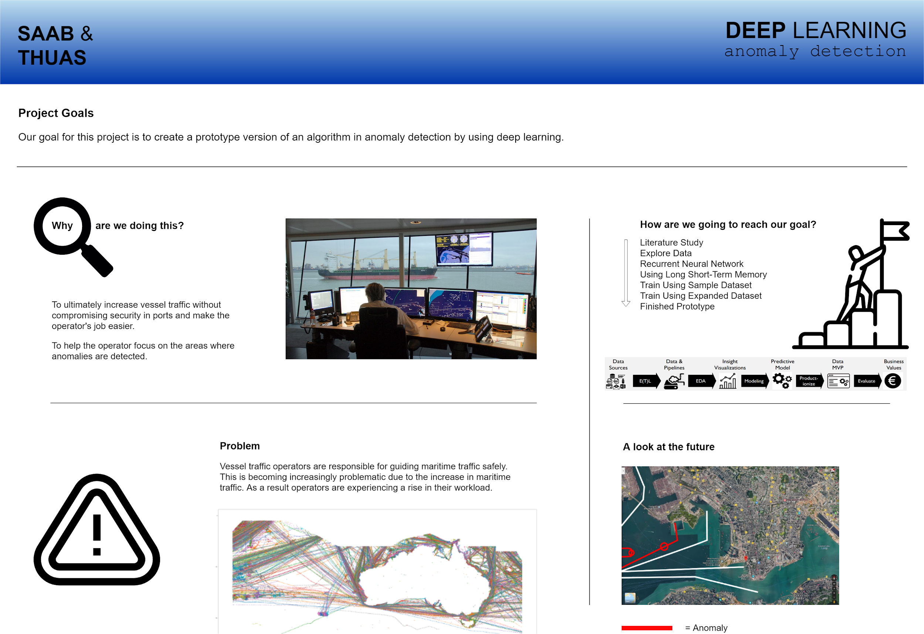
Informational poster

Slide 5
Last week
Literature study
Informational poster -> Saab office
Wednesday:
Sprint Review
Sprint Retrospective
Sprint Planning
NDA’s
(Temporary) Australian AIS dataset
Product Backlog

Slide 6
Last week
Literature study
Informational poster -> Saab office
Wednesday:
Sprint Review
Sprint Retrospective
Sprint Planning
NDA’s
(Temporary) Australian AIS dataset
Product Backlog

Slide 7
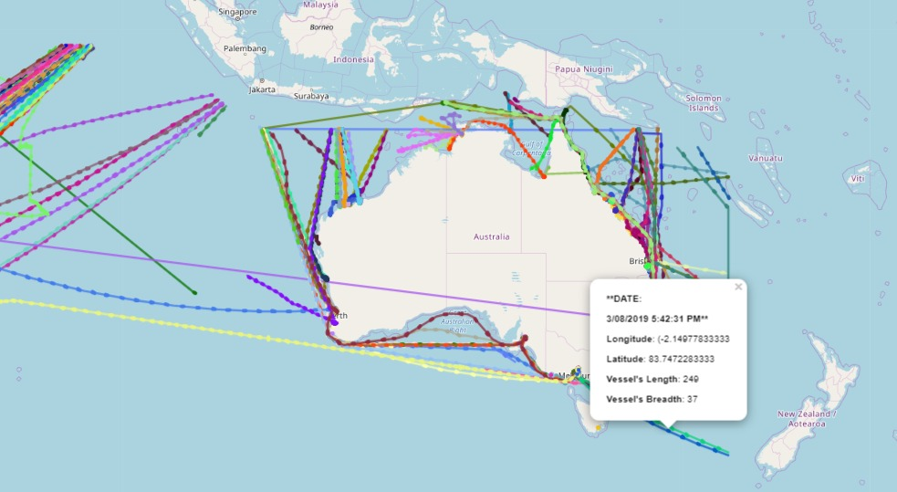

Slide 8
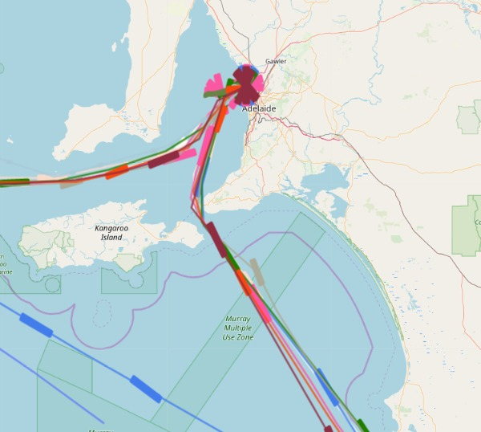

Slide 9
Last week
Literature study
Informational poster -> Saab office
Wednesday:
Sprint Review
Sprint Retrospective
Sprint Planning
NDA’s
(Temporary) Australian AIS dataset
Product Backlog

Slide 10
Product Backlog
Literature Study | As the product owner I want every point of the Scribbr manual to be included in the literature study; As the product owner I want to have a thorough research done by the project team, using at least 15 different literature studies that are all interconnected; As the product owner I want to have a literature study that is written in proper, scientific English with a max of 1 spelling/style error per page; As the product owner I want to have a literature study that is a good foundation for the potential publishable research that will be the end goal (next to the prototype).
Research | As a researcher I want a solid (SMART)research question so that we have a goal to build towards. As a researcher I want to define sub questions so we can answer our main question. As a researcher I want to write an introduction for the research by using the knowledge we gained from our literature study & our prototype. As a researcher I want to write about materials and methods used for the research by using the knowledge we gained from our literature study & our prototype. As a researcher I want to write the results we found for the research by using the knowledge we gained from our literature study & our prototype. As a researcher I want to write a conclusion for the research by using the knowledge we gained from our literature study & our prototype. As a researcher I want to write a discussion for possible next research by using the knowledge we gained from our literature study & our prototype. As a researcher I want to write an abstract for the research by using the knowledge we gained from our literature study & our prototype.
EPICS | User Stories
Anomaly Detector Prototype | As a user I want to be able to see alerts that are generated by the anomaly detector; As a user I want to be able to hear alerts that are generated by the anomaly detector; As a user I want to hover my mouse over the generated alert and see more information about anomaly, so I can act accordingly; As a user I want to click on the generated alert to assign it to multiple labels (anomaly seen, anomaly solved, anomaly inaccurate); As a user I want to be able to remove the generated alert by right-clicking on the alert in the anomaly detector.
Recurrent Neural Network Design | As the product owner I want to be able to see the design of the recurrent neural network that uses long short term memory; As the product owner I want to see in the design what features are used for training and predicting the data.
Implementing Recurrent Neural Network Research | As the product owner I want to use good practices that are researched by other researchers so the project has a head start instead of researching everything from the beginning; As a developer I want to experiment with Recurrent Neural Networks and Long Short-Term Memory to know how to use it; As the product owner I want to see a Recurrent Neural Network successfully implemented; As the product owner I want to see a Recurrent Neural Network with Long Short-Term Memory to be successfully implemented in the prototype; As the product owner I want to know the recall, precision and accuracy of the neural net; As the product owner I want to have the algorithm trained with a training data set of 70% and a testing data set of 30%.

Slide 11
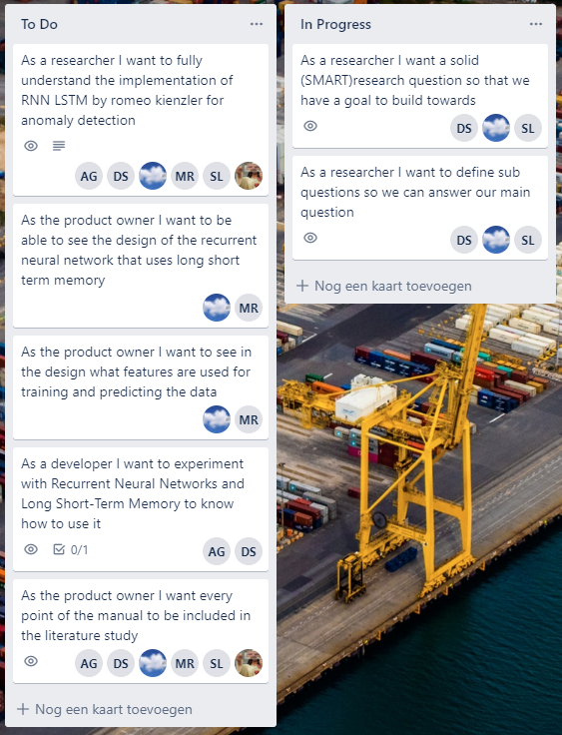
This week
Literature review
Research question
Understand RNN and LSTM networks
Make a design for our RNN with LSTM
Experiment with implementing RNN LSTM networks

Slide 12
Any Questions?

Slide 13
Thank you!

